Slide 1

Internet Research
Wrap-up and Review

Slide 2
List 4 Examples of Internet Browsers
Edge
Chrome
Firefox
Safari

Slide 3
What is the most widely used browser?
Google Chrome

Slide 4
Explain How you can add a web page to the favorites/Bookmark bar?
Click on the star at the top of the web browser
Make sure your favorites/bookmarks bar is turned on.

Slide 5
List Examples of Search engines
Google
Bing
Yahoo
Ask
Dog pile

Slide 6
What is the most widely used search engine?
Google

Slide 7
What are generally the most reliable sites?
edu
.gov
Sometimes .org

Slide 8
Give reasons Why copying and pasting, Plagiarism is a bad idea…
Learn very little, if anything
Being dishonest
Teacher will know
Failing grade
Embarrassment
Defeats purpose of the assignment

Slide 9
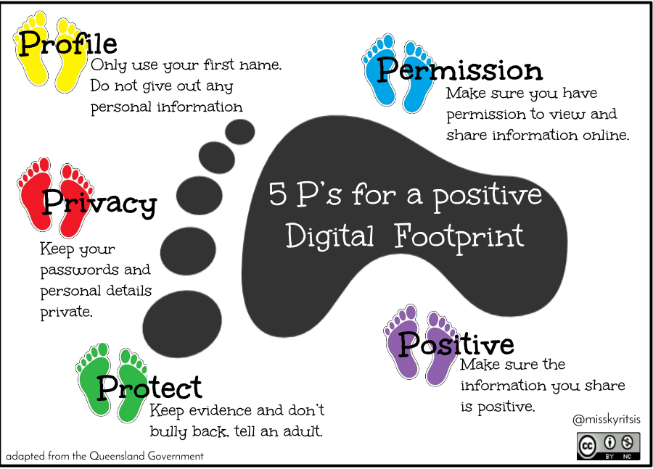
What are the 5 p’s of a positive footprint
Profile
Permission
Positive
Protect
Privacy

Slide 10

What does think stand for
T - True
H - Helpful
I - Inspiring
N - Necessary
K - Kind

